Slide 1
Research Software Engineering in the Arts and Humanities
Community and capacity building
Dr Anna-Maria Sichani
BRAID fellow - Research Associate in Digital Humanities,
Digital Humanities Research Hub
School of Advanced Studies, University of London

Slide 2
Research Software Engineering capability in the Arts and Humanities
2004-2015: Digital Humanities specialists as “swiss army knives”
data cleaning, analysis, modelling & architecture
software development
UX/UI
systems admin
back ups - maintenance
IT support
2015 - today: DH projects with far more complex software needs & BIG data
! Need for a specialised skillset → AH RSE

Slide 3
Research Software Engineering capability in the Arts and Humanities
Definition
AH RSEs are a subset of a much larger cross-disciplinary and cross-sector group of RSEs who “combine expertise in programming with an intricate understanding of research” and research infrastructures.
Profiles
deep experience working with AH content and research questions → deep understanding of AH content, methods, and research culture
work within cross-disciplinary RSE ‘pools’ (often oriented towards STEM research) and occasionally assigned to AH projects → new perspectives and facilitate interdisciplinary transfer of tools, infrastructure, and methods.

Slide 4

The AH RSE workforce is invisible in some ways, working in enabling roles at the intersection of research and technology.

Slide 5
Policy context and alignment
2010 Software Sustainability Institute (SSI) - “Better software, better research”
2013 UK Research Software Engineers Association
several RSE groups in research institutions, eg UCL - 2012 → over 25 RSE groups across the UK
2015 Research Software Group Leaders Network4
2019 Society of Research Software Engineers
RSE community has also been recognised and supported by funding bodies for its contribution
—-------
2018 King’s Digital Lab (KDL) , King’s College London (used the RSE term for AH)
2019 Alan Turing Institute - Turing Humanities & Data Science Interest Group (H&DS)
Digital Humanities Institute , University of Sheffield | University of Exeter | University of Cambridge | University of Edinburgh ….

Slide 6
Infrastructure for Digital Innovation and Curation in Arts and Humanities (iDAH) - UKRI AHRC
Policy and Engagement Fellowship (1-8/2022)
Scope out how existing UKRI DRI capabilities (ARCHER2, JASMIN) should be expanded to serve AH research communities
Create a roadmap with focus on technical requirements and business case for a federated ecosystem of DRI
Support the AHRC in developing its strategy to further enhance the arts and humanities digital research infrastructure on a national level.
Assess and integrate RSE capacity → Leveraging RSE provision within A&H digital infrastructure

Slide 7
Policy and Engagement Fellowship in Digital Research and Innovation Infrastructure
(iDAH) Research Software Engineering (RSE) Steering Group
2 workshops: May 25th, June 29th 2022 | Chair: James Smithies, Professor of Digital Humanities, Department of Digital Humanities, King’s College London, facilitator: Anna-Maria Sichani, UKRI Policy and Engagement Fellow in Digital Research and Innovation Infrastructure
Workshop 01: Problem, Opportunities, Requirements definition and discussion.
Workshop 02: Discussion of early draft of report.
Members: 33 people, 21 institutions; A&H and STEM for UKRI alignment and creative thinking.
Output: Scoped, costed report detailing problems, opportunities, requirements as input to UKRI / AHRC iDAH investment
Guided by Terms of Reference.

Slide 8
Policy and Engagement Fellowship in Digital Research and Innovation Infrastructure
(iDAH) Research Software Engineering (RSE) Steering Group
Leveraging RSE provision within A&H
AH RSE - wide interpretation : Analysts, designers, archivists, managers, project managers, developers, system administrators, and RSE-identifying academics too: a broad and evolving spectrum.
Enabling AH RSE voices, vision, and expertise across the whole of the UK and all institutions.
Support-by-example RSE career pathways and provision within A&H structures across the whole of the UK and all institutions
Alignment to RSE Society and Software Sustainability Institute definitions of RSE is assumed.
Strategically develop (the need) for RSE capability within the iDAH investment
Advocate in practice for a better integration of RSE in A&H funding agendas
Act as a centre of RSE excellence and innovation for the wider UK RSE and UKRI communities

Slide 9
(community-driven) Outputs
1)Report :
Sichani, A.-M., Ahnert, R., Baker, J., Beavan, D., Ciula, A., Crouch, S., De Roure, D., Francois, P., Hetherington, J., Jeffries, N., McGillivray, B., Ridge, M., Terras, M., Tupman, C., Turner, M., Weinzierl, M., Willcox, P., Winters, J., Wynne, M., & Smithies, J. (2023). iDAH Research Software Engineering (RSE) Steering Group Working Paper (v.1.0). Zenodo. https://doi.org/10.5281/zenodo.8177926
2)AHRC RSE Advisory Group as a central, permanent AH RSE function (TBC)
to review technical proposals
define models (data, processes, workflows)
environmental standards
career paths & promotion metrics
technical research standards in alignment to UKRI RSE and infrastructure initiatives
design policies to support sustainability and archiving of funded repositories and services

Slide 10
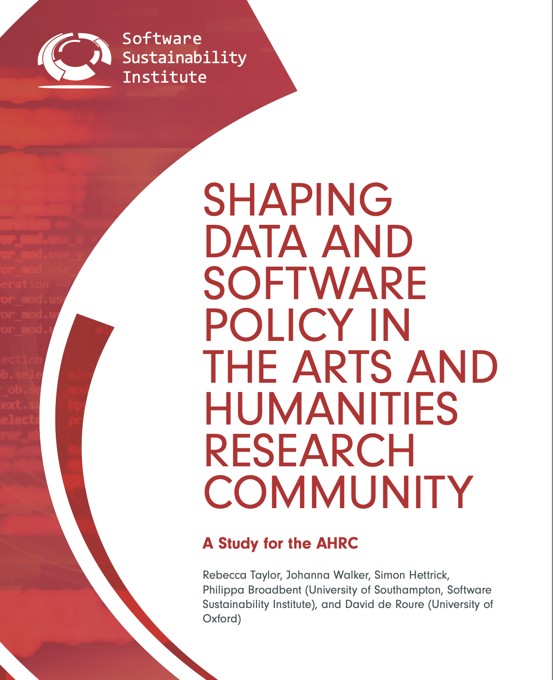
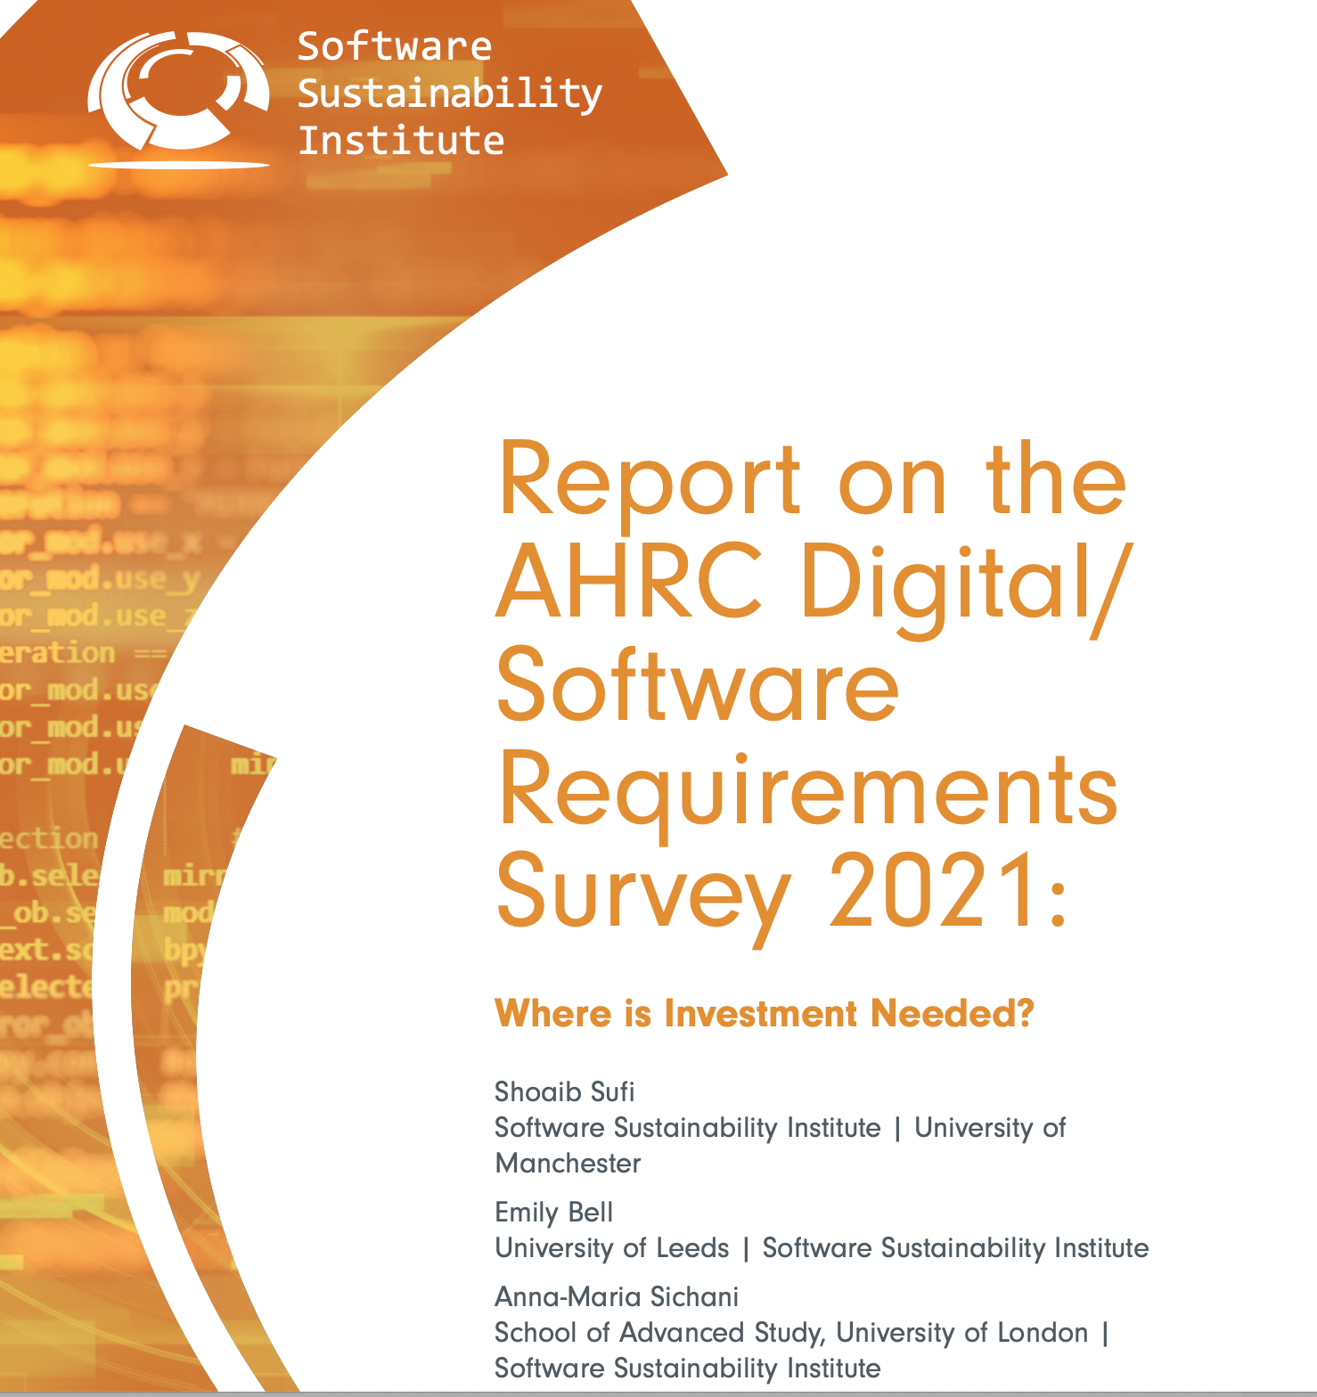
In the meantime…

Slide 11

Research Software Engineering in Arts & Humanities Community Interest Group
(Spring 2023 )
CIG Coordinators -Facilitators
Stavros Angelis, Maynooth University Kathryn Cassidy, Digital Repository of Ireland
David Kelly, University of Galway
Anna-Maria Sichani, School of Advanced Study, UoL
(previously)
Mary Chester-Kadwell, University of Cambridge
David Beavan, Alan Turing Institute

Slide 12
Background and aims
Origins in AHRC Infrastructure for Digital Innovation and Curation in Arts and Humanities (iDAH)
Intersection of research and technology increasingly important in AH
Community-oriented goals & activities
Community-focused discussions: to discuss issues and learn from each other.
Knowledge exchange and collaboration: formal and informal opportunities to build capacity and develop talent.
Advocacy and policy-focused interventions: to make a difference to policies and investment.

Slide 13
Our Values
Grassroots initiative
Open, inclusive, collaborative, safe space
Who is welcome ?
Anyone involved or interested in RSE in AH, broadly conceived.
Irrespective of job title, career stage, background, etc.
Discrimination and harassment not tolerated
Accessibility

Slide 14


Resources - channels of communication
Slack channel
#ah-rse at uk-ie-dh-assoc.slack.com
GitHub repo
github.com/stavrosangelis/research-software-engineering-in-the-arts-and-humanities
I

Slide 15

Community Interest Group Survey (2024)
Preliminary findings
Very diverse community (Inst.Location, Employment status/Contract Type, Job Titles, Discipline, Education)
Variety in professional Identity (software dev, research, management/admin, teaching/training)
Team structure (Work with same researchers, part of dedicated research group) and Work pattern (working alone/in groups/teams/ in pools, Relation to industry, Bus factor)
Active towards a pan-institutional RSE Collaboration

Slide 16
Top Barriers to RSE in AH
Unrecognised AH RSE activity
Lack of long term career prospects
Lack of clear career paths
Funding sources
Institutional support for funding applications
Top priorities for such an initiative (ranked by importance):
1.collaboration frameworks
2.policy interventions
3.professional rights

Slide 17
Community - driven initiative and group
From the community and for the community
A grassroots, bottom-up approach
Inclusive and open ethos
Co-design roadmap, goals and activities
Next steps
Nurturing long-term engagement
Demonstrating impact
Across institutions
Funders’ level
Policy level
Sustainable growth

Slide 18


Data/Culture: Building sustainable communities around Arts and Humanities datasets and tools
National RSE Capability skilled in Arts & Humanities
Stakeholder group
•Started as 26 members
•Turned into 40 authors
•Range of skills and expertise

Slide 19
Process
•3 Workshops
•Email group and Dashboard with resources
•Newsletter updates
•Collaborative writing
•Dedicated writer
Workshop 1
•User stories
•Challenges and Opportunities
•Problem Definition
•Change
Workshop 2
•Capability Model (incubator?)
•Objective setting
•Themes: Skills, Foundation, Research Collaboration delivery
•What roles should be central to the operation
Workshop 3
•Values
•Scope and Aims
•Operating Model and Governance
•Programme Design and Priorities
•Skills (Clementina)
•Implementation

Slide 20

Towards a National Research Software Engineering Capability in Arts and Humanities Research: a Roadmap
Executive Summary
•Glossary and Key Terms
•Introduction
•Vision, Aims and Objectives
•Challenges and Limitations
•Programme of Work
•Delivery Approach
•Conclusion
•Acknowledgements
•Reference List
DOI: 10.5281/zenodo.15083396

Slide 21
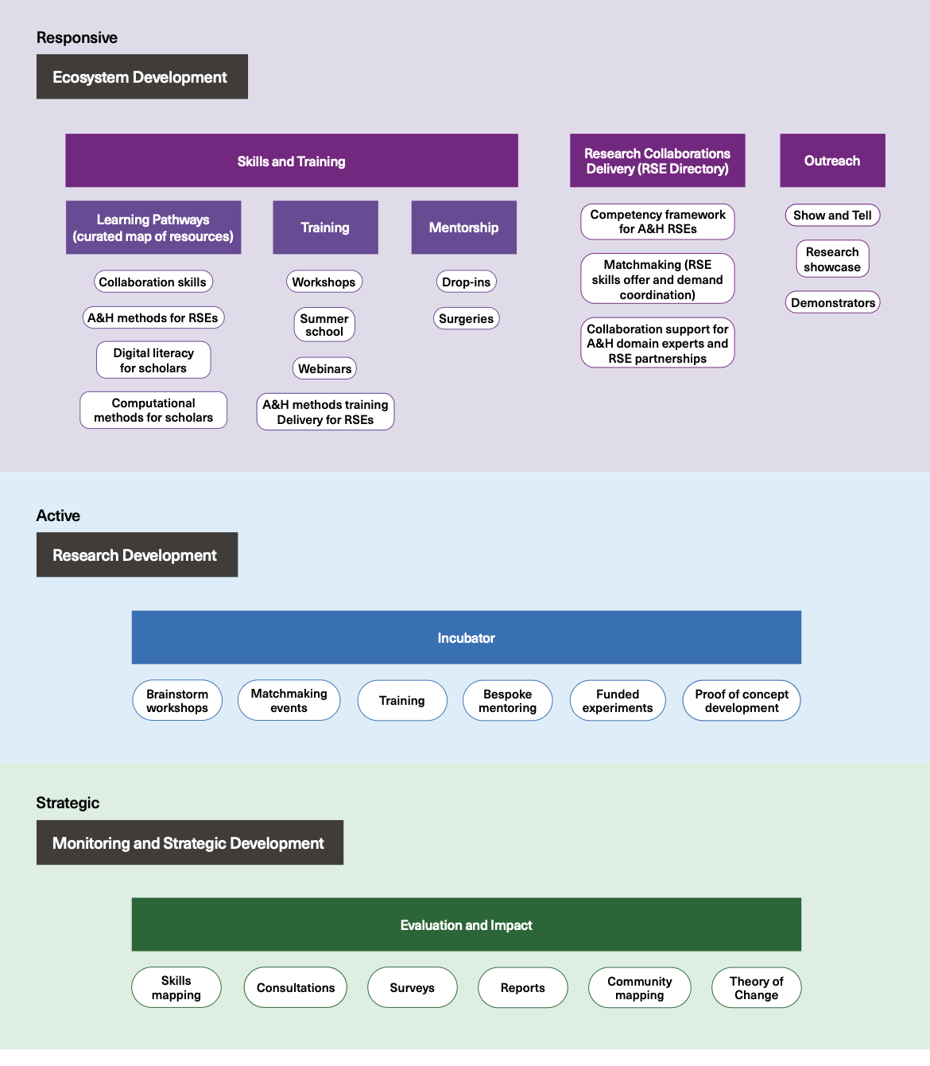

Slide 22
Three main areas of focus
Ecosystem Development:
•Directory of RSEs – deliver collaborations
•Skills: learning pathways, training
•Outreach
•Advice/Mentorship
Research Development
* Incubator for tools and methods
•Matchmaking events
•Funding for experiments
Monitoring and Strategic Development
Tech Changes, but the ecosystem changes (policy, investments, players)
•Impact Assessment
•Theory of Change
•Research Intelligence: Ecosystem Mapping, Surveys, Consultations to feed the implementation:
•Skills mapping: define training needs and offer
•Ecosystem mapping: provision gaps across the country
•Annual survey: support funders design calls

Slide 23
Delivery Approach
•Governance and Staffing
•Implementation and running (Years, 1, 2 and 3)
•Year 1: Team, ToC, DP, Mapping, Partnership Mechanism
•Year 2: RSE Directory, Annual Survey, Incubator, Evaluation
•Year 3: Publish Survey, Strategy, Business Case, activities+

Slide 24
Three Collaboration Case Studies
•The National Archives (UKGWA)
•Centre for Data, Culture and Society (Rapid Prototyping Sandpit)
•KDL (Modular Digital Research Infrastructure Design)
Investment Levels
•Recommended Level
•Prioritised
•Minimum

Slide 25
RSE AH roundtable at DH UK IE Annual Event : Maximizing collaboration towards RSE in A&H (17/6/25)
RSE AH CIG
Roadmap
KDL
DISKAH
SSI
•In what ways can we foster stronger collaboration with these existing organisations and teams to benefit our community?
•How can this community make meaningful and sustainable contributions to the broader RSE and research infrastructure community?

Slide 26




SSI reports
RSE AH CIG
iDHA RSE AH steering group
Roadmap
KDL
SoRSE
SSI
2010
2019
2021
2024
2016
2023
2025
RSE AH summer school - Turing / Edinburgh

Slide 27
Conclusions & challenges
•Bold vision to transform how RSE and A&H researchers work together
•The need to invest given the pressures in tech changes
•Develop skills, innovation, careers, leadership
•A more dynamic, collaborative, strongly connected community
•Risks of not investing
•Global leadership

Slide 28
Slack channel
#ah-rse
at uk-ie-dh-assoc.slack.com
Questions? Ideas?
Thank you !
annamaria.sichani@sas.ac.uk
RSE AH Roadmap

